Slide 1
Project Title: EnterPriseSys - Project II (Redemption)
Name: [KABEER ALI]
RollNo: [BITF20M018]

Slide 2
Technology Stack
Mention the technologies used in your project:
Frontend: React
Backend: Django
DB: SQLITE3

Slide 3
Why I choose This:
React: Explain its popularity, component-based architecture, and ease of use for building interactive user interfaces.
Django: Highlight its robustness, scalability, and built-in features for rapid development.

Slide 4
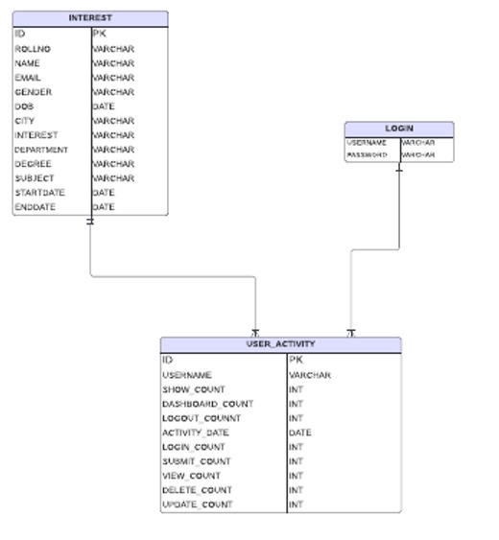
ERD:

Slide 5
Application Flow:
Applications Flow:
Seeing The options
User Login/Sign Up
Authentication from Server (Django)
Home Page with Multiple Options
Add Student
Students Pages with View , Edit , Delete
Dashboard of User Activities

Slide 6

Template Design, Color Scheme and Fonts, Dashboard , User Management
I have done project in react ,
Fonts and colors are taked from color pickers,
Dashboard is containing graphs using js libraries, user management is done using db connection

Slide 7
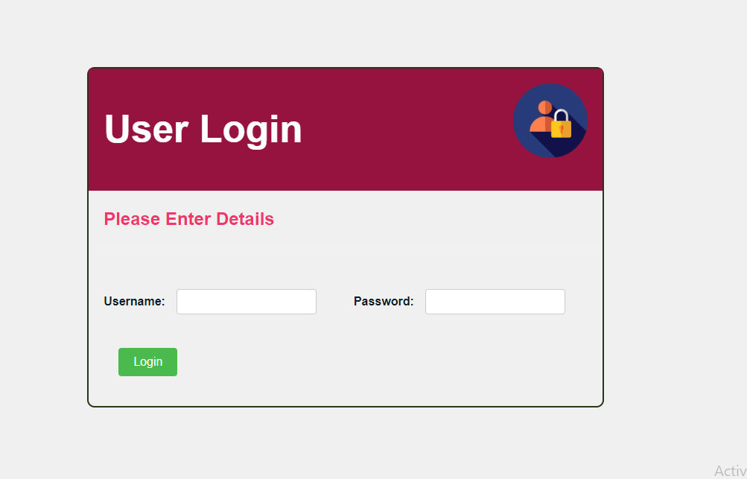

Slide 8
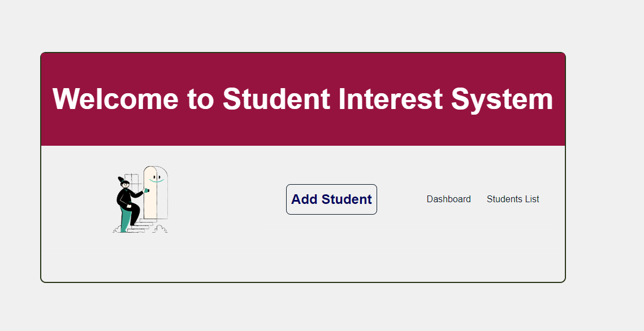

Slide 9
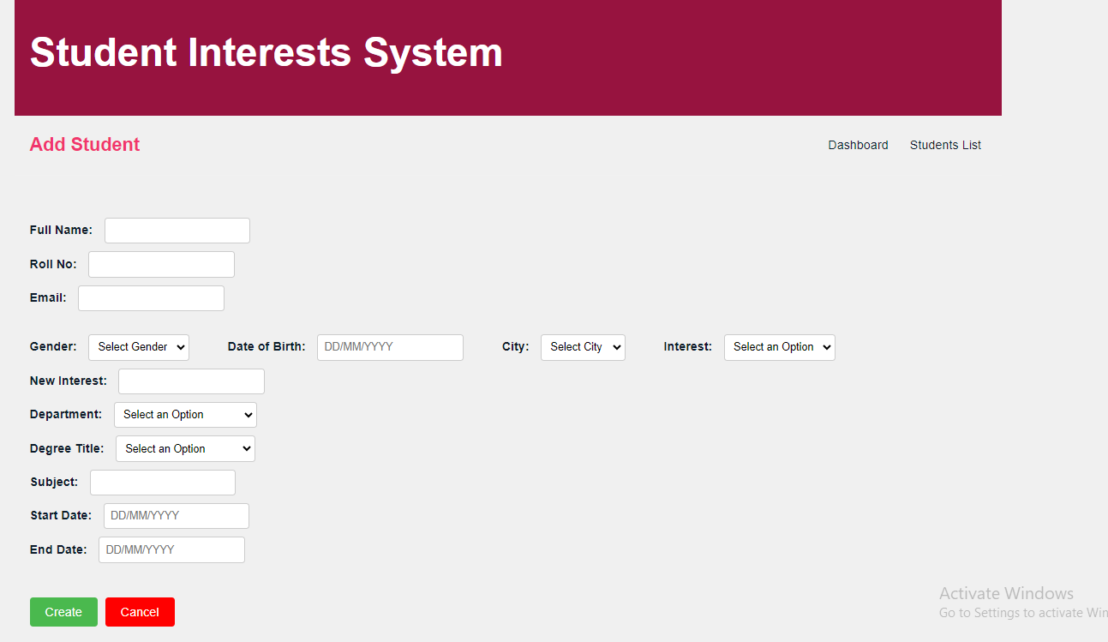

Slide 10
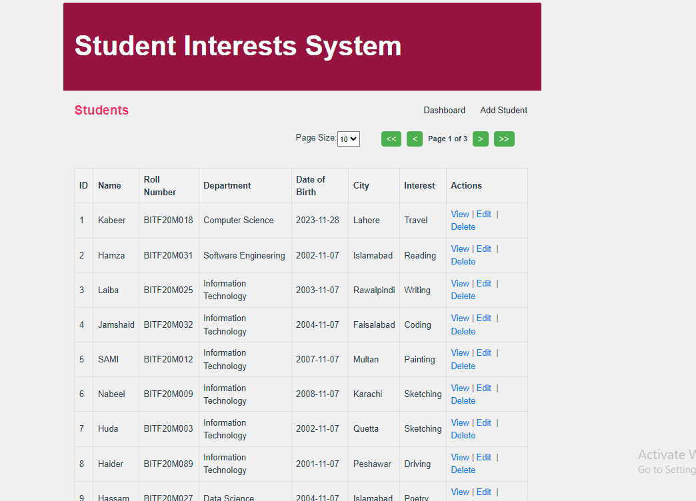

Slide 11
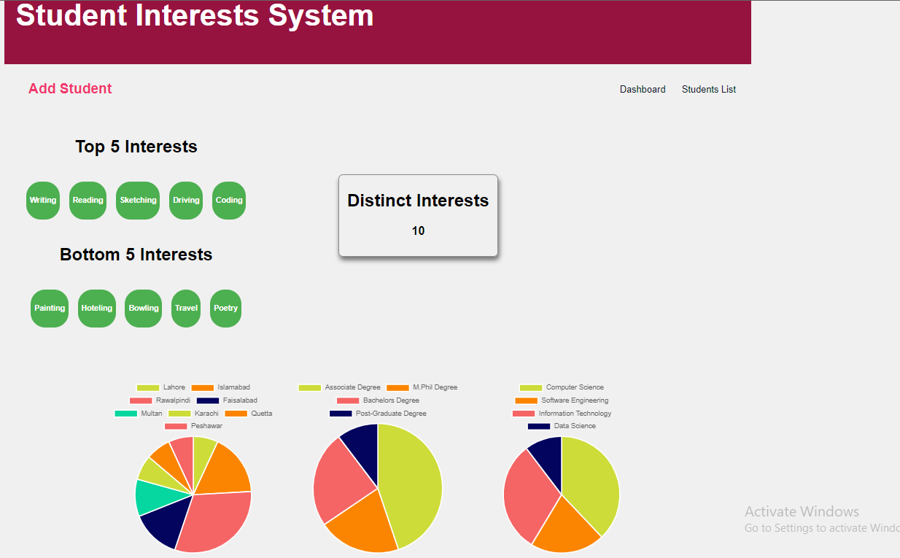

Slide 12
Conclusion:
It was Great Learning Experience with these Front end and back end technologies.

